Slide 1
Computational Thinking, Problem Solving, and Programming
TOPIC 4.0 – Computational Thinking
TOPIC 4
File I/O

Slide 2

REVIEW REVIEW REVIEW REVIEW REVIEW REVIEW
THE WARM-UP QUESTION
Write a python method that is the constructor method for a class called Plant that has a few attributes (variables) that it brings in and assigns

Slide 3
REVIEW REVIEW REVIEW REVIEW REVIEW REVIEW
THE WARM-UP ANSWER
def __init__(genus, species, height, numLeaves, inSeason):
self.genus = genus
self.species = species
self.height = height
self.numLeaves = numLeaves
self.inSeason = inSeason

Slide 4
READING FROM FILES
FILE IO
When we work with programs, we need to be able to store information to use later
If a game couldn’t store highscores, it wouldn’t be very fun
We do this by reading from files get data, and writing to files to save data

Slide 5

READING FROM FILES
FILE INPUT
First, we’ll cover reading from files
This is accomplished by the following code
file = open(“filename.txt”)
This creates a file object that we can read data from
It gets the file named filename.txt to read from

Slide 6
READING FROM FILES
FILE INPUT
Once the file is open, we read from it by calling its name
x = file.read()
print(x)
This code will print the entire contents of the file after storing them into x

Slide 7
READING FROM FILES
FILE INPUT
x = file.readLine()
y = file.readLine()
print(x)
print(y)
This code will print the first two lines of the file

Slide 8
READING FROM FILES
FILE INPUT
x = file.read(3)
y = file.read(4)
print(x)
print(y)
This code will print the first three characters followed by the next four characters

Slide 9
READING FROM FILES
LINE BY LINE
To read every line of the input file one at a time
For x in file
print(x)

Slide 10
READING FROM FILES
EXAMPLE: READING NAMES
f = open(“filename.txt”)
names = []
for x in f
names.append(x)
print(names)
Now we have every name that was in the file stored in an array!

Slide 11
READING FROM FILES
EXAMPLE: READING NAMES
Reading in from files allows us to automate programs to use data that we don’t have to type in
This allows our programs to be more flexible and useful
If we write data to a file when a program closes, we could load the file when the program opens to resume progress

Slide 12
WRITING TO FILES
FILE WRITING
Writing to files involves a bit more work
We write lines of text into a .txt file
Must specify that our file object is in the writing mode
file = open(“filename.txt”, “a”)
adding the “a” at the end puts us into append mode

Slide 13
WRITING TO FILES
APPEND MODE
Append mode adds any changes to the file at the end of the current file
file.write(“This is the new text on the file”)

Slide 14
WRITING TO FILES
APPEND MODE
File Text Before:
This is the OLD text on the file
file = open(“filename.txt”, “a”)
file.write(“This is the new text on the file”)
File Text After:
This is the OLD text on the file
This is the new text on the file

Slide 15
WRITING TO FILES
WRITE MODE
file = open(“filename.txt”, “w”)
Use a “w” instead of an “a”
Write mode replaces all text in the current file
file.write(“This is the new text on the file”)

Slide 16
WRITING TO FILES
APPEND MODE
File Text Before:
This is the OLD text on the file
file = open(“filename.txt”, “w”)
file.write(“This is the new text on the file”)
File Text After:
This is the new text on the file

Slide 17
CREATING FILES
CREATING FILES
What happens if we try to write to a file that doesn’t exist?
Python will create that file for us!
What happens if we try to read from a file that doesn’t exist?
Python will not know what to do, and it will error out
If you want to create a file in code without writing to it,
f = open("myfile.txt", "x")
Use “x” instead of “a” or “w”

Slide 18
DELETING FILES
DELETING FILES
What if you want to delete a file?
First, you have to import the os library at the top of the script
import os
This is short for operating system, meaning it can interact with Windows
Then, you can delete the file, but you should check it exists first

Slide 19

DELETING FILES
DELETING FILES
import os
if os.path.exists(“filename.txt”):
os.remove(“filename.txt”)
else:
print(“The file does not exist”)

Slide 20
DELETING FOLDERS
DELETING FOLDERS
import os
os.rmdir(“folderName”)
This will remove the folder by that name
rmdir is short for Remove Directory (aka folder)

Slide 21
FILE IO
IMPORTANT NOTES
When working with files, the file needs to be in the same folder as the .py script for Python
There are options to open files for reading and writing data at the same time
These become tricky to work with as it’s tough to maintain the data integrity, so try to use only read or write at once
If desired, you can also open files in binary, which lets you read each byte of data rather than the words
We won’t be using this ability in this class

Slide 22

FILE IO
Vocab to remember
Read
Write
File
Man I don’t know what else to put here

Slide 23
REVIEW REVIEW REVIEW REVIEW REVIEW REVIEW
THE WARM-UP ANSWER
Write a python method that is the constructor method for a class called Plant that has a few attributes (variables) that it brings in and assigns

Slide 24
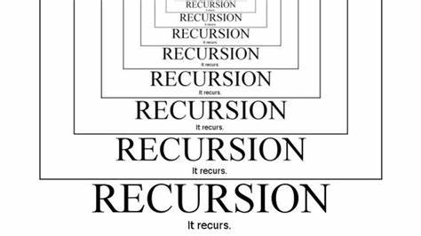
Topic 5.1.1 – THINKING RECURSIVELY
Recursive thinking
Different way of tackling problems
Continually breaking down a problem into smaller versions of itself
Eventually, you hit a small enough problem to solve yourself
Recursion is the process of breaking down a problem into smaller pieces which you either already know the answer to, or can solve by applying the same process to each piece, and combining the results.

Slide 25
Topic 5.1.1 – THINKING RECURSIVELY
PRACTICAL EXAMPLE
Think about your path being blocked by a big rock
You can split this big rock in two, then split those halves, so on and so forth until you can pick up the rocks to clear the path

Slide 26
Topic 5.1.2 – THINKING RECURSIVELY
Slightly less practical example
Go to mathisfun.com/games/towerofhanoi.html
The Towers of Hanoi are the quintessential example of a recursive algorithm
You must move all the discs from the left tower to the right tower, in order
You can only move one disk at a time
Smaller discs may NOT be placed under larger discs
Try to solve the towers for 3 discs, then 5, then 7

Slide 27
Topic 5.1.2 – THINKING RECURSIVELY
Towers of hanoi
The towers of Hanoi increases dramatically in time taken to solve with each increase
You must break down the problem step-by-step to move each disc
Each disc movement requires you to do a handful of prior disc movements
By the time you’ve added one new disk, you must once again move every other disk again
O(2^{n}) algorithm (not very efficient)

Slide 28
Topic 5.1.3 – THINKING RECURSIVELY
Towers of hanoi
General algorithm:
Move n – 1 discs from tower A to tower B, leaving disc n on tower A
Move disc n from tower A to tower C
Move n-1 discs from tower B to tower C

Slide 29
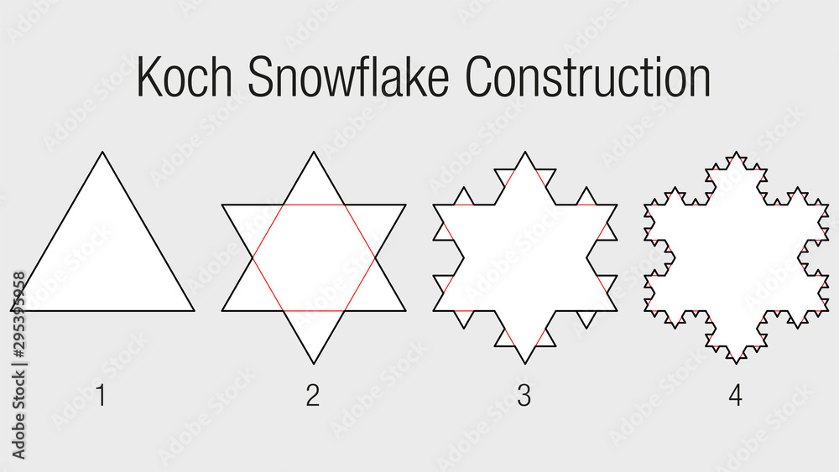
Topic 5.1.1 – THINKING RECURSIVELY
Koch’s snowflake
Each recursive step adds a new layer of triangles

Slide 30
Topic 5.1 – THINKING RECURSIVELY
Okay big man how do I code it?
First off, that was kind of mean
Second off, recursion typically happens using procedures
The procedures check to see if the problem is broken down enough, if not, they break it down some more

Slide 31
Topic 5.1 – THINKING RECURSIVELY
VOCAB TO REMEMBER
Write a python method that is the constructor method for a class called Plant that has a few attributes (variables) that it brings in and assigns

